Slide 1
Data wrangling! Introduction to the Tidyverse
Daniel Padfield

Slide 2
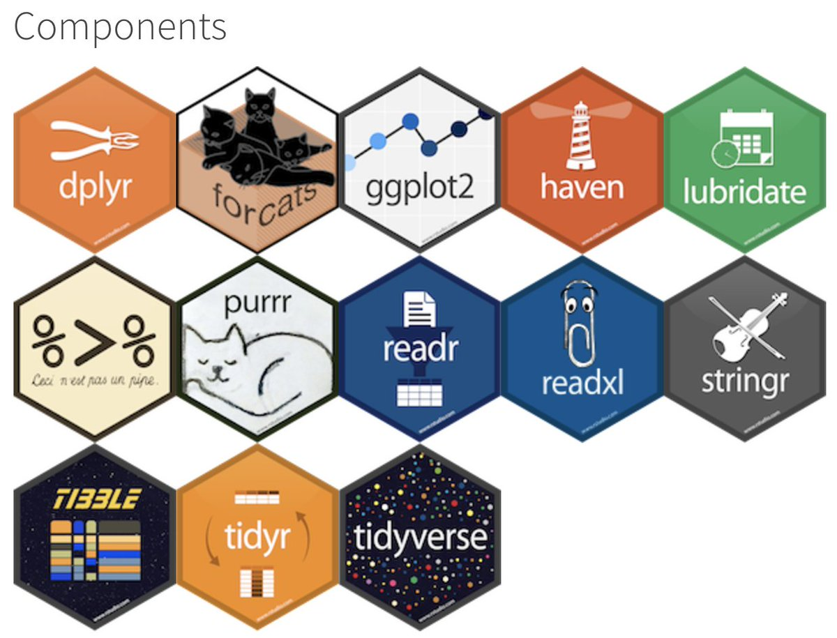
What is the tidyverse?
Set of packages designed by Hadley Wickham and his team at Rstudio
Install the complete tidyverse using:
install.packages(“tidyverse”)

Slide 3
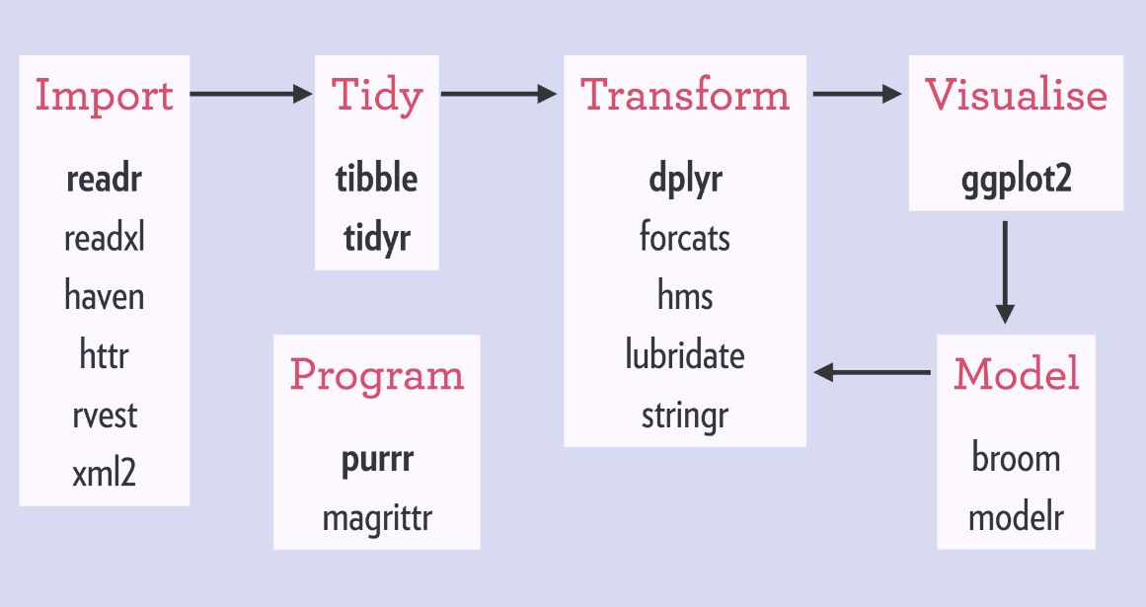
What is the tidyverse?
Set of packages designed by Hadley Wickham and his team at Rstudio
Try to create a set of tools for full-stack analysis that use the same syntax and set of rules
Install the complete tidyverse using:
install.packages(“tidyverse”)

Slide 4
Bind multiple files with purrr and readxl

Slide 5
Tidy column names with janitor
Working data, column names can often be confusing
No CAPITALS, numbers as first letter or spaces
janitor::clean_names() automatically renames column names to be all lower case and replaces spaces with “_”, puts an X in front of the first number

Slide 6
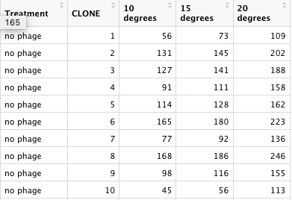
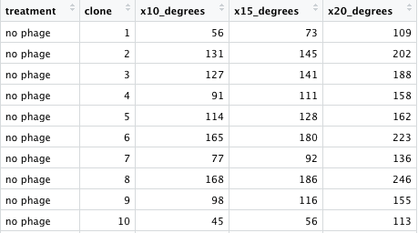
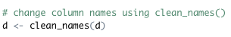
Tidy column names with janitor
From this…
To this…

Slide 7
Stack data (i.e. long format) using gather()

Slide 8
Select columns with select()

Slide 9
Subset rows with filter()

Slide 10
Add columns with mutate()

Slide 11
Do the same function on many columns using mutate_at()

Slide 12
No more nested if_else() with case_when()

Slide 13
Piping with %>%

Slide 14
Summary data using group_by() and summarise()

Slide 15
Group-wise columns with group_by() and mutate()

Slide 16
Put it all together!

Slide 17
MicrobioUoE

Slide 18
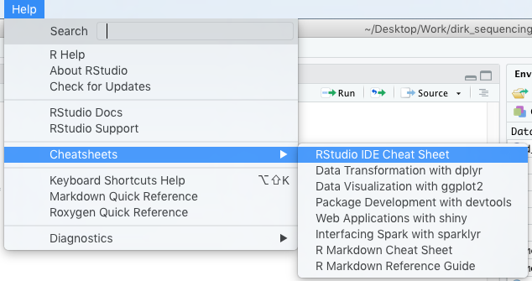
Cheatsheets for the tidyverse

Slide 19
Cheatsheets for the tidyverse

Slide 20
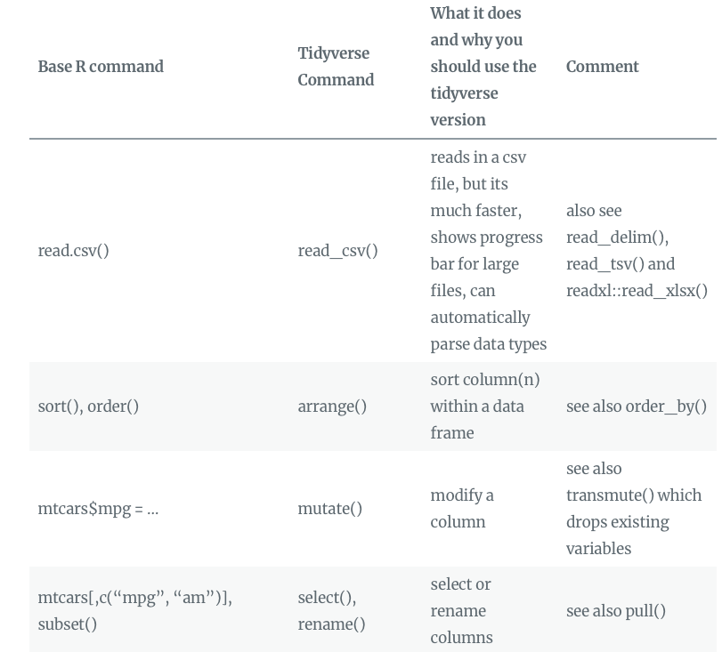
Moving from base R to the tidyverse
Blog post link!

Slide 21
Cheers!

